Slide 1





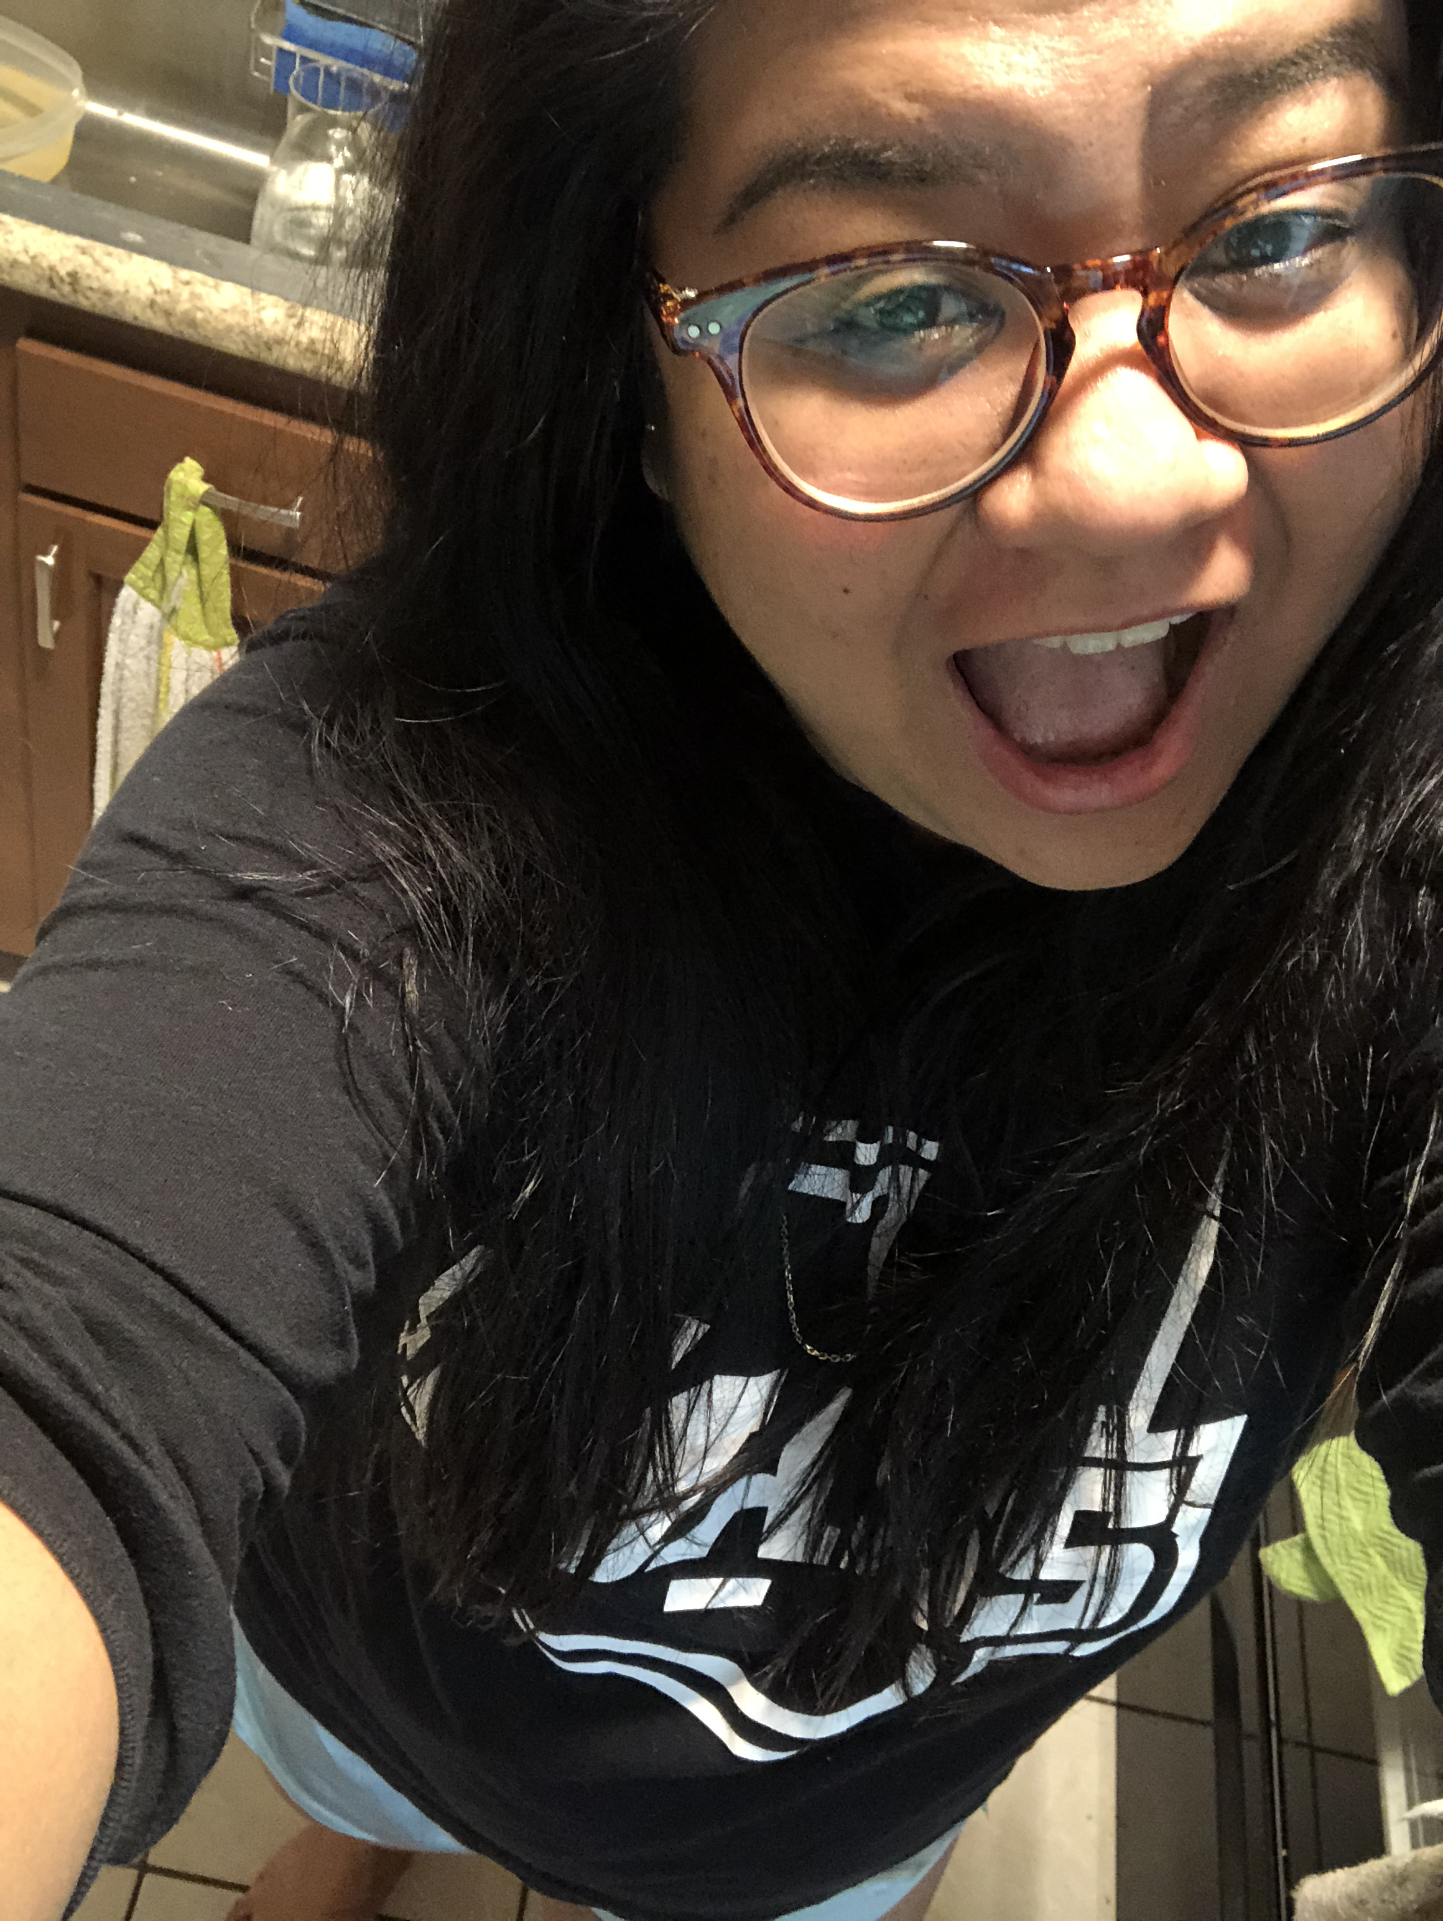
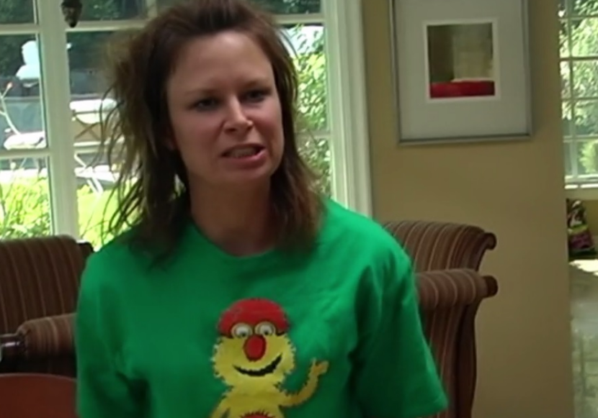


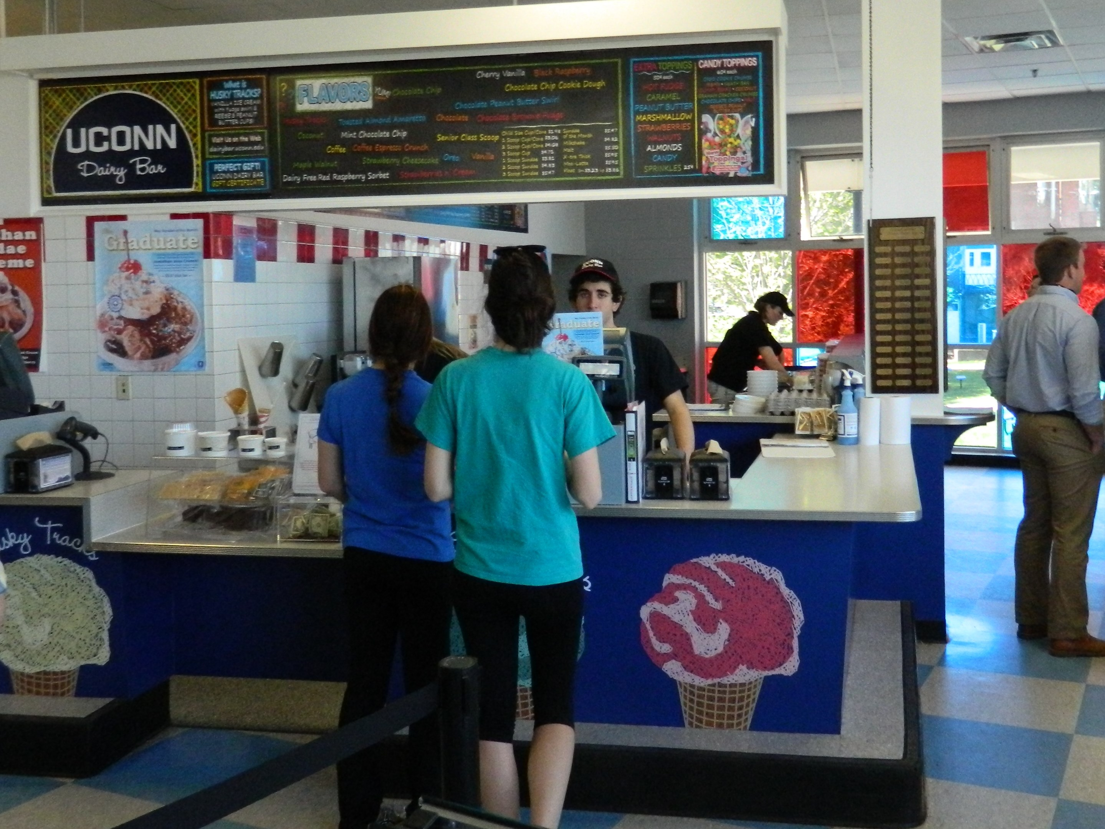


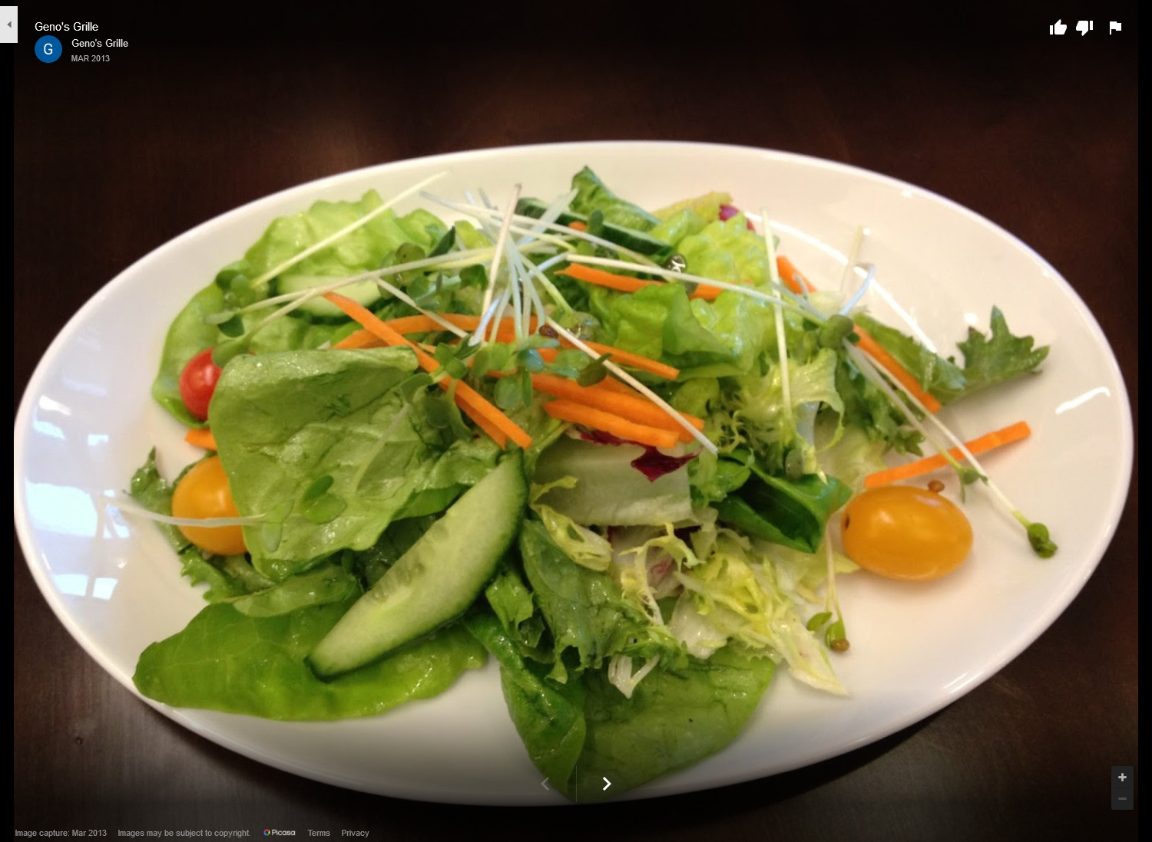
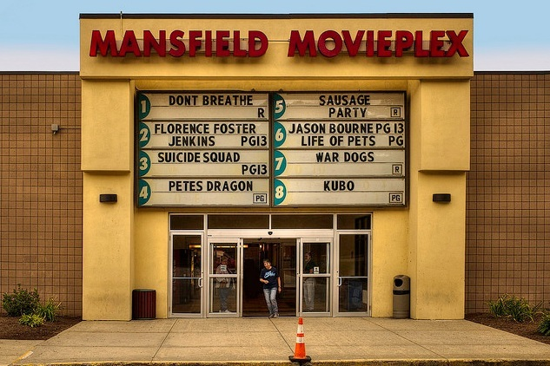

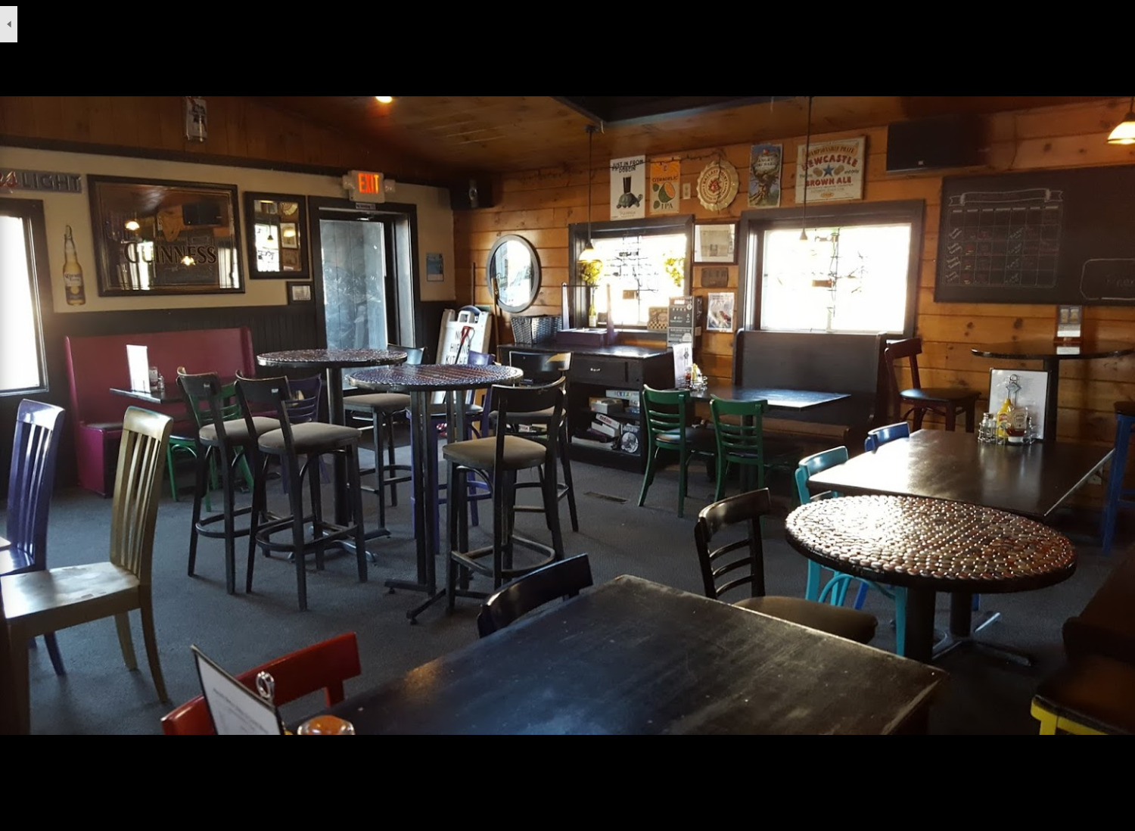
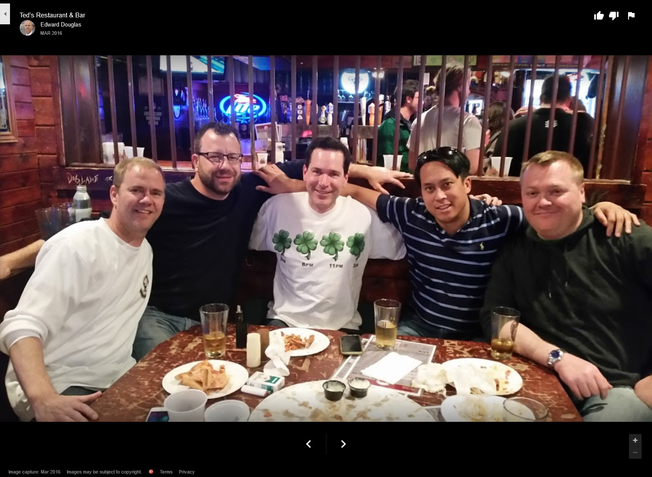
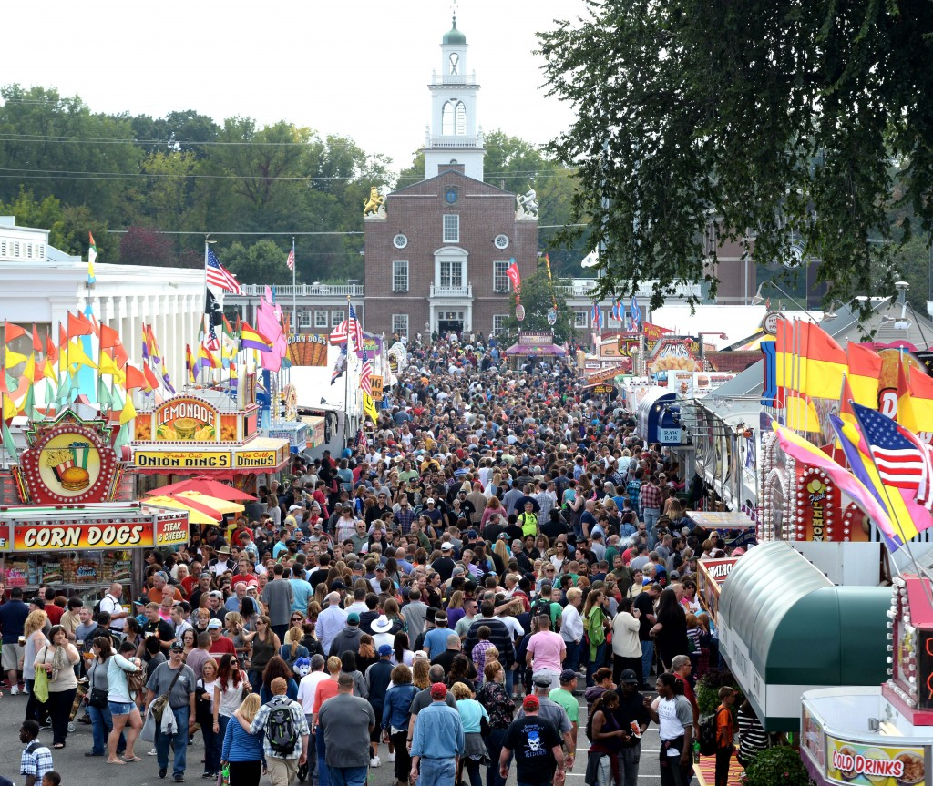

10:00 PM
10:00 PM
10:00 PM
10:00 PM
Find your date…
Tori's Profile
Types
Dates
Friends
Tori
Gail
Popular Near You
•••
UConn Dairy Bar
Starbucks
•••
UConn Dairy Bar
Ice Cream Shop
4.8 ★
278 Reviews
Easthampton, MA
User profile. Possibly contains information about their location and/or what kind of dates they enjoy.
An observation window looks onto the ice cream-making area at this longtime UConn-run scoop shop.
Geno's Grille
Mansfield Movieplex
Previous Dates with Tori
Search for date ideas!
Continue
10:00 PM
Types
YES
NO
Maybe

Slide 2
10:00 PM
Title

